Slide 1
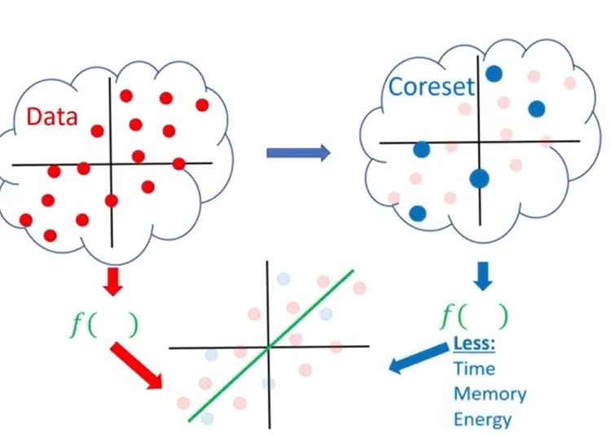
Introduce to Coreset

Slide 2
Outline of presentation:
I
Motivation & Coreset
II
How to compute a Coreset?
III
Applications

Slide 3
I: Motivation & Coreset
I.1
Motivation
I.2
What is coreset?
I.3
Coreset properties

Slide 4
I.1: Motivation

Slide 5


Motivation: Big Data
How BIG is Big Data?
Limited hardware
Computation: IoT
Energy: smartphones
Limited time
- Real-time decision making

Slide 6
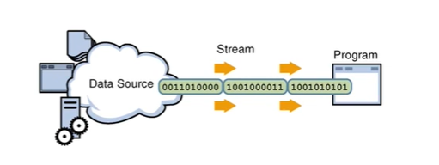

Motivation: Streaming & Distributed Data
New computation model
Streaming real-time data
Data is being received in chunks
Or one by one
Distributed data
Across multiple machine
Or in the cloud

Slide 7
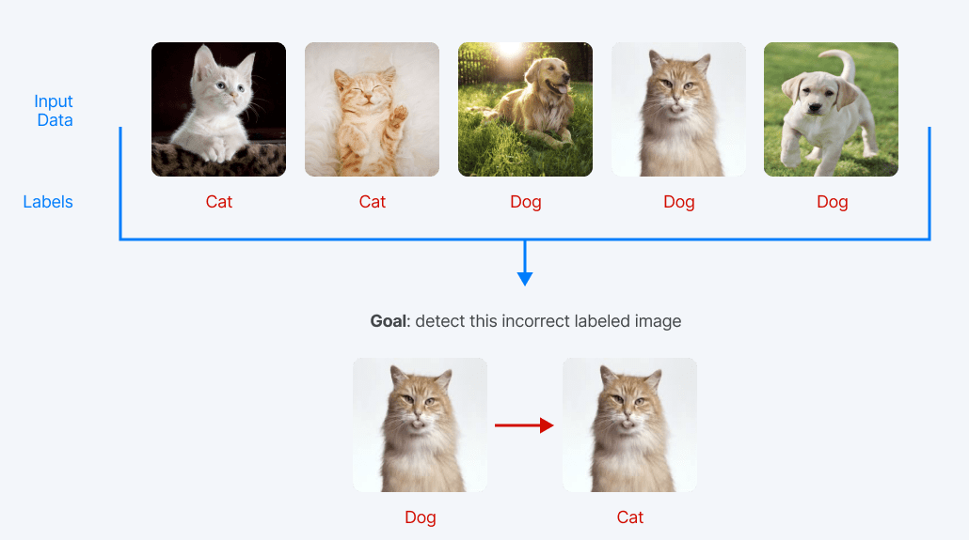
Motivation: Incorrectly labeled data

Slide 8
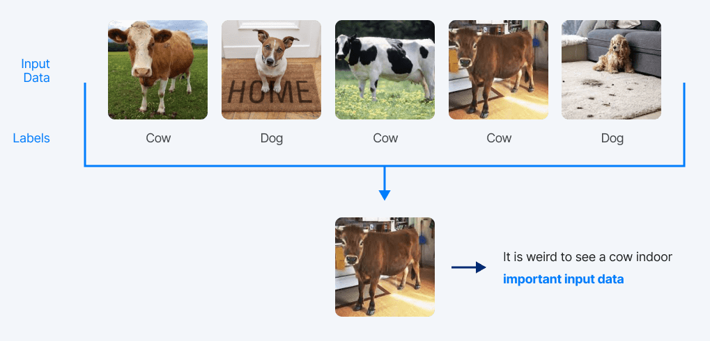
Motivation: Data quality

Slide 9
I.2: What is Coreset?

Slide 10
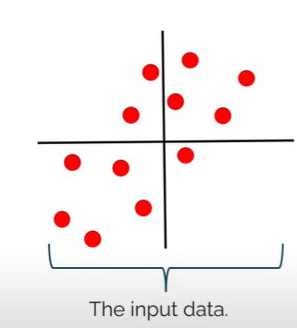
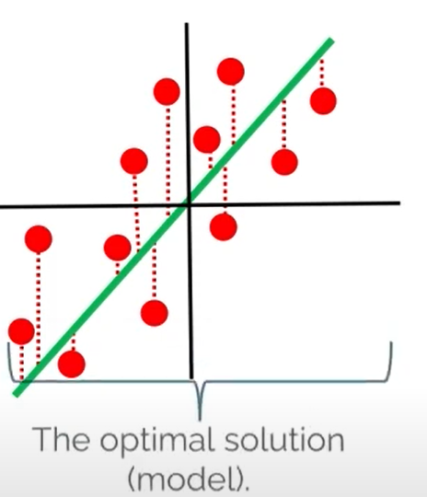
A general Machine Learning Procedure
ML Algorithm

Slide 11
New approach is needed
Common approach: Design faster algorithms
Alternative approach: Make the data smaller

Slide 12
A Coreset

Slide 13
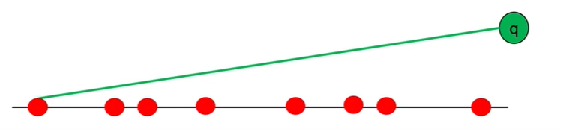
Warm-up
Give a set P of n point on a line, another point q
Goal:
Return the farthest point in P from q in O(1) time

Slide 14
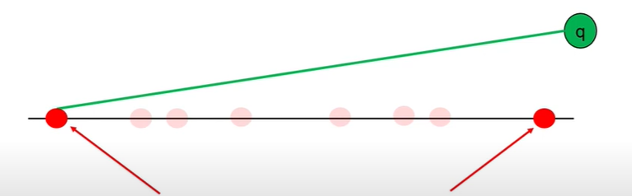
Warm-up
Give a set P of n point on a line, another point q
The farthest point is one of the two end points
=> Delete all others points

Slide 15
Defining a problem
We need to define:
The input set (denote by P)
The query set (denote by X)
The cost function: we need to optimize

Slide 16
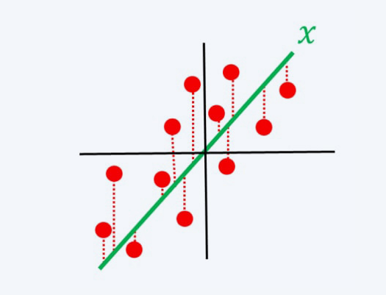

Defining a problem
Ex: Linear regression
The input set:
and their label
The query set X is composed of every vector in
The cost function to optimize:

Slide 17
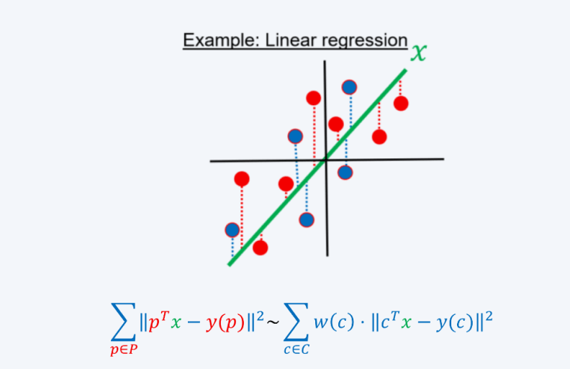
Defining a coreset
Let P be an input set
Let X be the query set
Let
be a cost function
A coreset is pair of (C, w)
where C ⊂ P and w: C -> R
such that for every query
x ∈ X: cost(P, x) ≈ cost((C, w), x)

Slide 18
I.3: Coreset properties

Slide 19
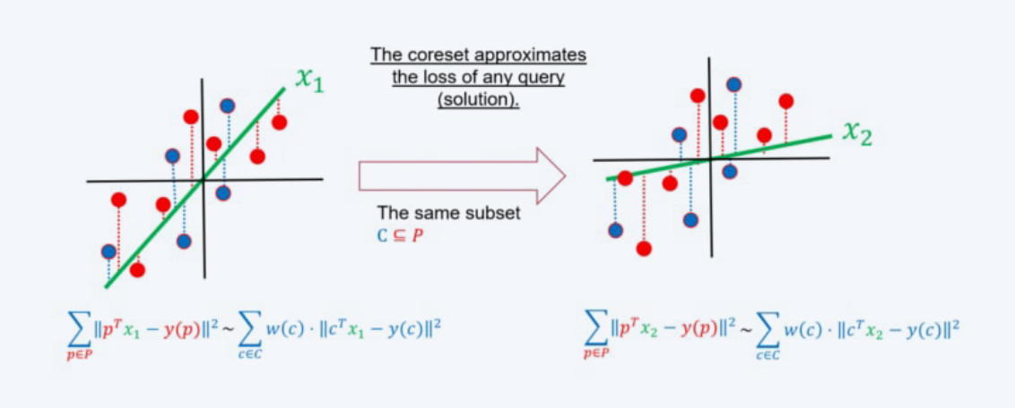
Coreset approximate any query (solution)

Slide 20
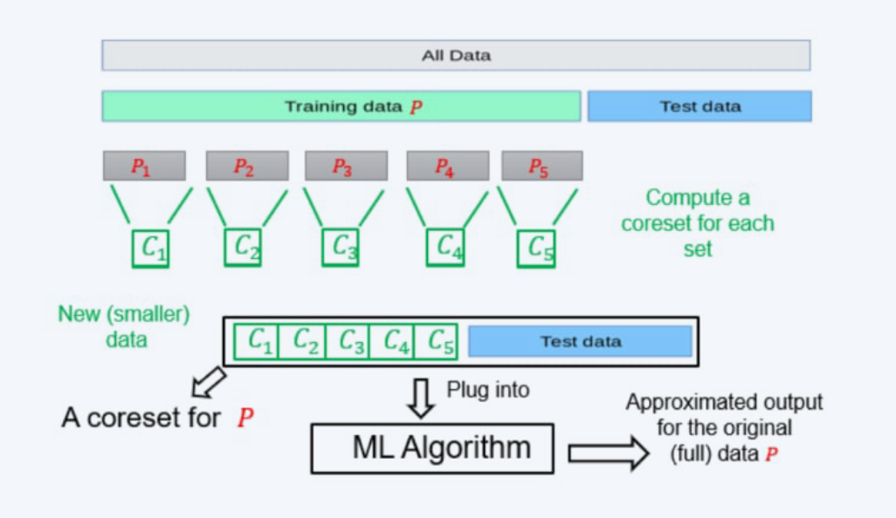
Union of Coreset is Coreset

Slide 21
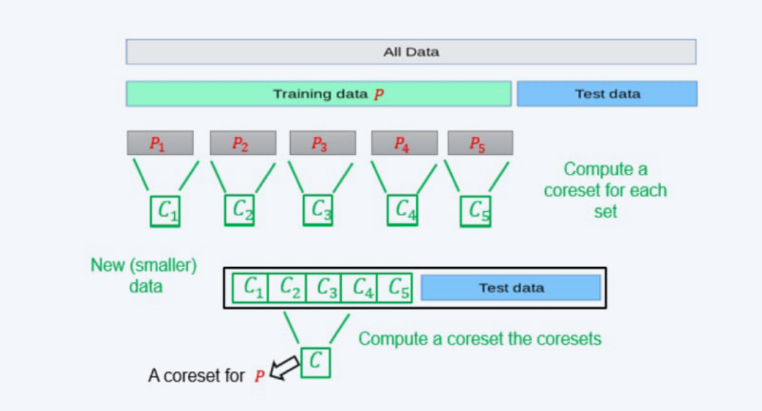
Coreset of Coreset is Coreset

Slide 22
II: How to compute a
Coreset?

Slide 23
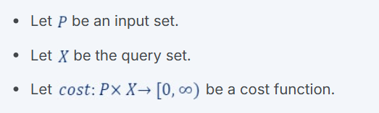
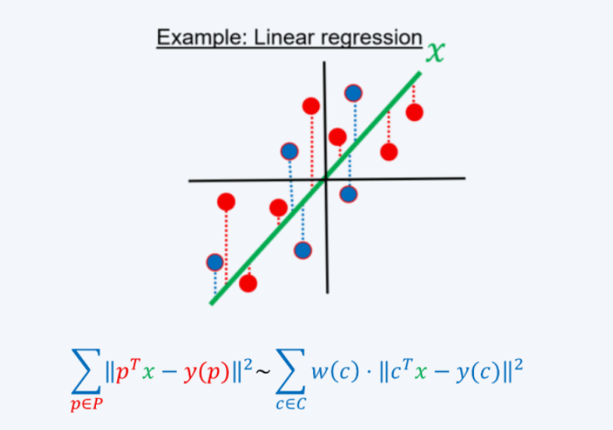


Computing a Coreset
For every p ∈ P let s(p) ∈ [0, 1] be a number defining its importance/sensitivity.
Set
C := Sample m (m > 1) points according to s(p) / t
For every p ∈ C:
With high probability (C, w) is a coreset for
(P, X, cost), C ⊂ P, w: C -> R such that for every query x ∈ X: cost(P, x) ≈ cost((C, w), x)

Slide 24
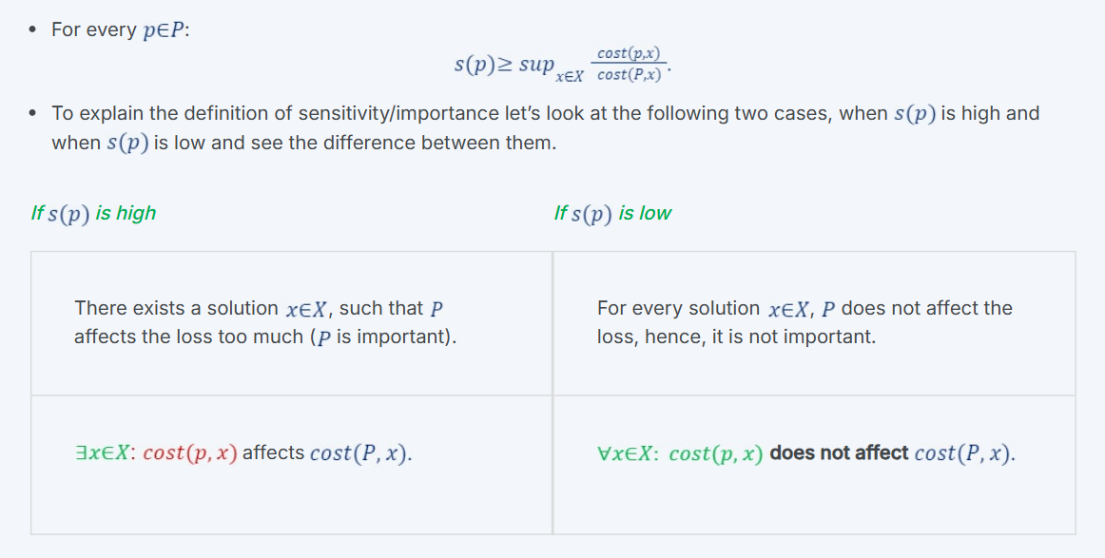
How to compute the importance s(p)?

Slide 25
III: Applications

Slide 26
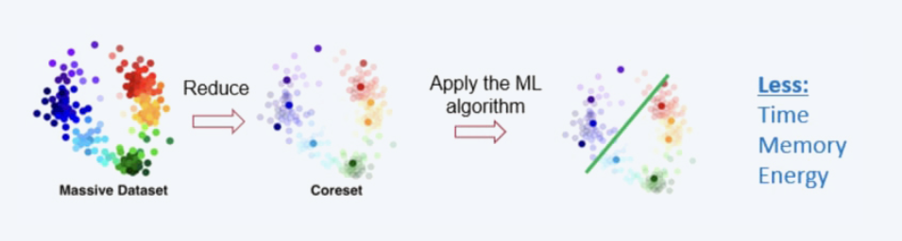
Limited hardware/time
Limited hardware
Computation: IoT
Energy: smartphones,
Limited time
- Real-time decision making

Slide 27
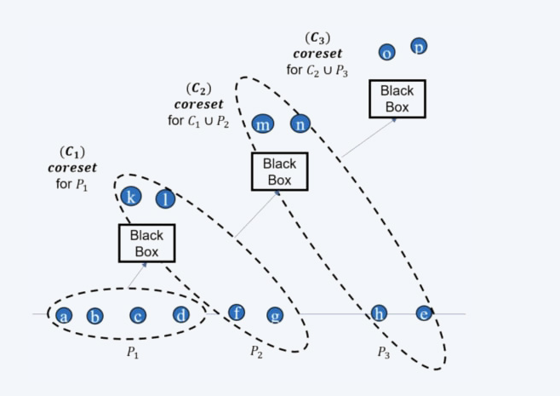
Streaming Coresets

Slide 28
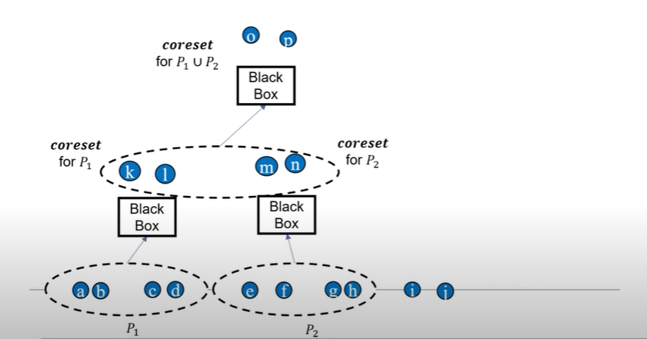
Streaming tree + Distributed data

Slide 29
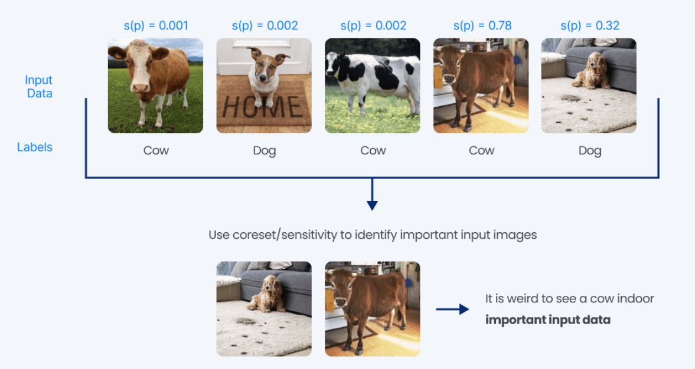
High-Quality Data

